Slide 1

Understanding Gradients
The coffee background is just cuz I like coffee :)

Slide 2

1. Understanding Partial Derivatives
Definition: A partial derivative tells us how much a function changes if we move a little bit in the direction of one variable (e.g., +x or +y).
Key Question: "What happens to f(x,y) if I move slightly along the x-axis or y-axis?"
Example:
If you move a little in the +x direction, the partial derivative ∂x/∂f​ gives the rate of change in that direction.
Similarly, ∂y/∂f​ does the same for the +y direction.
Lil demo: https://demonstrations.wolfram.com/PartialDerivativesIn3D/

Slide 3

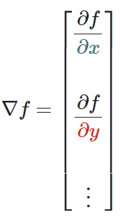
Moving Beyond Partial Derivatives
Observation: You can also ask, "What happens if I move in a direction between the axes, like halfway between +x and +y?“
A gradient vector is just the derivative with respect to each variable in the function, aligned in a vector :)
Partial derivatives only give change in the cardinal directions (along x or y), but we want to know the rate of change in any direction.
Another demo: https://www.geogebra.org/m/sWsGNs86

Slide 4

The Gradient as a Unified Machine
Definition: The gradient is a single vector that compiles all the partial derivatives.
Key Property: It answers, "What is the rate of change if I move in any direction?“
For a vector v, the gradient tells you the derivative in the direction of v.
Remarkable Insight: The derivative in diagonal directions (like y=xy = xy=x) is related to the derivatives along +x and +y.
The gradient unifies this relationship when the function is differentiable.

Slide 5

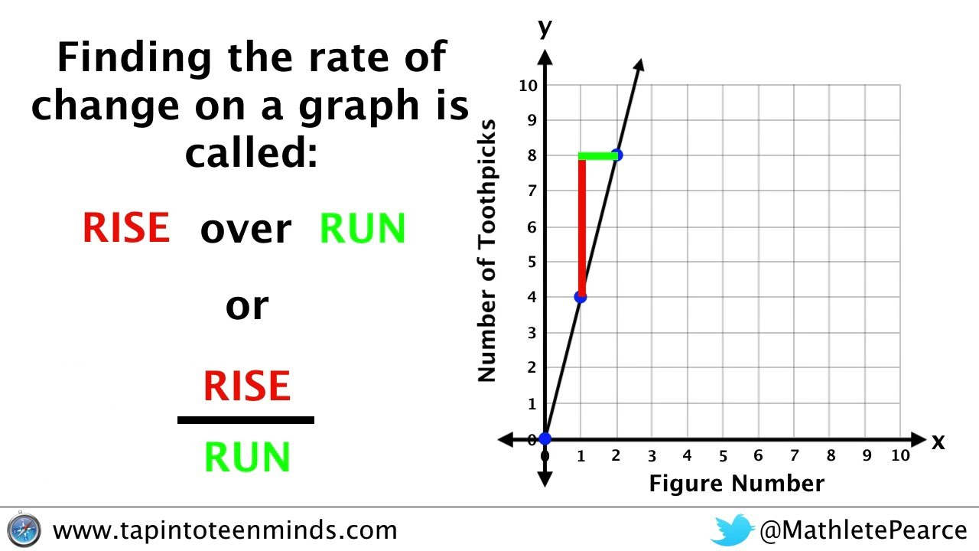

The Gradient and the Limit Definition
The derivative in any direction is defined as:
​ $\text{Directional} \text{Derivative} \text{in} v=\lim_{h→0}\frac{f\left(p+h\right)−f\left(p\right)}{h}.]$
Division by h:

Slide 6
Putting it all together
We the gradient tells us where the steepest ascent is, we need to find the steepest descent, so we go the opposite way.
https://www.desmos.com/calculator/uwdujfbtzf

